Slide 1
Mid-Term Project
“Golden Years”
Jessica Banoke
Angela Darel
Keith Feeney
Charlene Moore

Slide 2
Golden Years
Help seniors connect
Teaching the uses of skype, email etc.
Opening the internet world
Bringing back the joy of life
Giving the news about bingo, old style dancing parties and many more
Organising field trips
Managing health
Explaining tests results
Booking medical transport

Slide 3
Innovation
Golden Years was created to
help senior citizens enjoy life
provide education on technology use
help understand medical issues and test results
Application that allows to
search for nearest events
book and pay for events
search and book medical support
provides e-learning experience for seniors

Slide 4
Technologies used
PHP
MySQL
Visual Studio
C#

Slide 5
PAYMENT
Calendar booking
Adding event to cart
Accepting payment ( credit cards only)

Slide 6
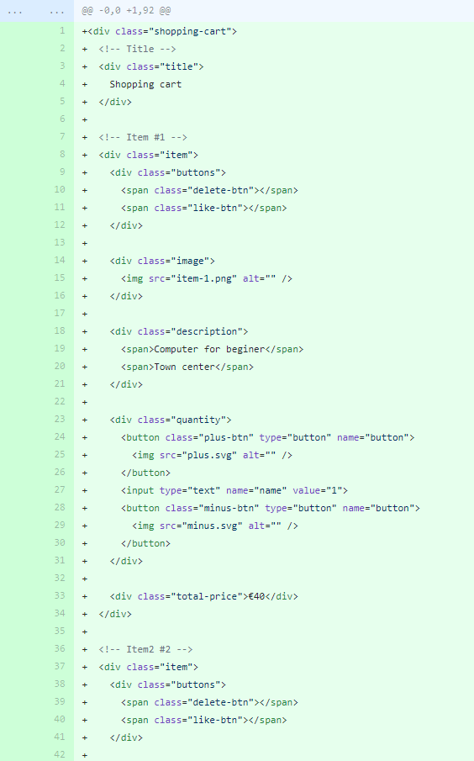
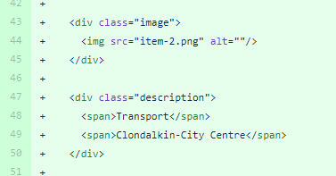
Code to add items to cart
Item 1 and 2

Slide 7
Current issues
Connecting the Database to Web Application
Learning PHP
Overall aesthetics
Group dynamics

Slide 8
Progression
Connect the database to application
Look and feel of the Web Application

Slide 9
References
<Use Harvard References>

Slide 10
Thank you

